Slide 1

Parallel Algorithms for Butterfly Computations
Group Members:
Ayaan Khan (22i-0832)
Ayaan Mughal (22i-0861)
Salar Shoaib (20-0830)

Slide 2

Introduction & Applications
Efficient Butterfly Counting
Key Technologies
Real-World Impact
Uses METIS for partitioning, MPI for distribution, OpenMP for threading.
Focus on scalable parallel counting in bipartite graphs.
Applications in social networks, recommendations, clustering, anomaly detection.

Slide 3
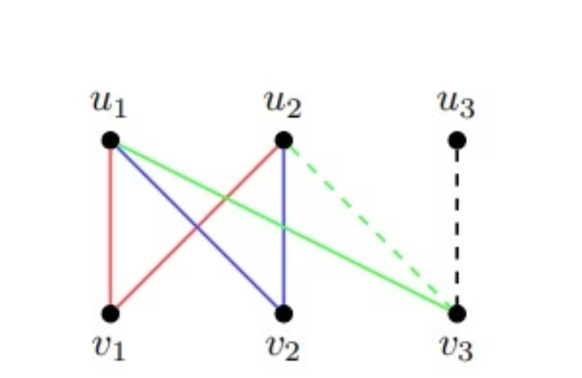
Understanding Butterfly Motifs
Bipartite Graphs
Vertices split into two sets (L and R). Edges connect L to R only.
No edges within the same set
Common in co-purchase, co-authorship data
Butterfly Structure
A 2x2 biclique: two L-side and two R-side vertices, all connected.
Represents dense local structure
Captures co-occurrence patterns

Slide 4




Motivation & Challenges
Why Butterflies?
Scale Issues
Combinatorial Explosion
Detect communities, spam, and co-occurrence patterns in networks.
Graphs may have millions of vertices and edges.
Sequential algorithms are too slow for large graphs.
Iterate over neighbor pairs (wedges)
Check shared connections for each wedge

Slide 5





PARBUTTERFLY: Solution Pipeline
Wedge Generation
Vertex Ranking
Form triplets centered at low-rank vertices.
Assign rank by degree or degeneracy order.
2
1
Wedge Aggregation
3
Group wedges by endpoints to count shared neighbors.
5
Peeling (Optional)
4
k-tip/k-wing decomposition by butterfly participation.
Butterfly Counting
Pairs of wedges with same endpoints form butterflies.

Slide 6

Tools & Parallel Strategy
METIS
MPI
Partitions the graph into balanced subgraphs for parallel processing.
Distributes partitions across processes for inter-node parallelism.
OpenMP
Enables intra-node parallelism for wedge generation and aggregation.

Slide 7

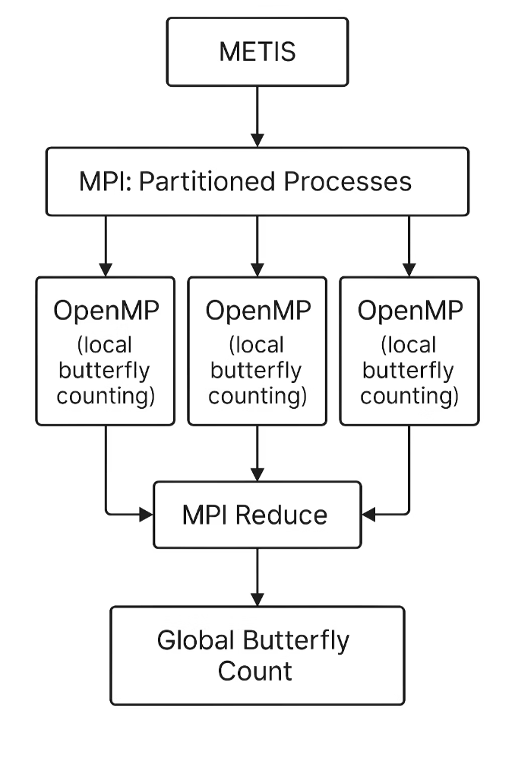




System Architecture
METIS Partitioning
Divides the graph into balanced parts.
MPI Processes
Each process handles a partition for distributed computation.
OpenMP Threads
Local butterfly counting within each process.
MPI Reduce
Combines local results into a global butterfly count.

Slide 8


Parallelization Details
METIS Partitioning
MPI Distribution
Each process receives a partition, exchanges boundary data, computes local counts.
Minimizes edge cuts, balances workload before MPI.
OpenMP Computation
Parallelizes wedge generation and aggregation using atomic updates or buffers.

Slide 9
Algorithm Implementation Steps
Partition Graph
1
Use METIS for balanced subgraphs.
Distribute with MPI
2
Load partitions into MPI ranks.
Local Computation
3
Rank vertices, generate and aggregate wedges, count butterflies.
OpenMP Parallelism
4
Enumerate and aggregate wedges in parallel.
Result Gathering
5
Merge results with MPI_Reduce.

Slide 10

Benefits & Scalability
Speedup
MPI Overhead
Significant speedup over sequential baseline.
Minimal overhead due to METIS partitioning.
Vertices
Scalability
Handles graphs with millions of vertices and edges.
Strong scaling as nodes increase, foundation for advanced mining.

Slide 11

Thank You
We appreciate your attention and interest throughout this presentation.

